Slide 1
PATTERN RECOGNITION AND MACHINE LEARNING
- UTKARSH BHANDARI

Slide 2

A two-step hybrid approach for voiceprint-biometric template protection
Submitted by:
Utkarsh Bhandari
BT18cse006
Submitted to:
Dr. Nitin Kumar
Assistant professor

Slide 3
Overview
1 : Introduction
2: Theory
3: Experimental Results
4: Conclusion
5: Bibliography

Slide 4
Introduction
With the recent advancements in speech recognition or in general, biometric systems; their security becomes imperative as it is open to vulnerabilities.
Before the content of this research paper can be accessed, we need to understand the need for template protection and existing methods for template protection
There have been a number of template protection techniques, but there is always a trade of between security and performance.
This research paper presents a hybrid approach that utilizes the benefits of both Template transformation and Biometric Cryptosystem.
Link to article: Link

Slide 5
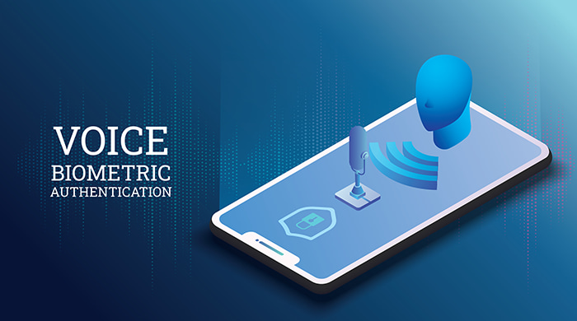
THEORY

Slide 6
ADDRESSING THE NEED FOR THE HYBRID APPROACH
  Voiceprint Biometric Systems face great challenges under the open Environment.
  The loss of voiceprint is permanent and voiceprint always connects to the identity of one user. Therefore, security of these templates becomes an important as well as an important issue.
  Typical solutions based software can be classified two main categories :
  -> Template Transformation and Biometric Cryptosystem.
  Template transformation applies passwords or functions to the input and query biometrics. By changing the key, it's easy to change the template. However, the security mainly relies on the protection of the key. And it's difficult to find suitable one-way functions to obtain non invertible template.
  Biometric Cryptosystems make use of biometric features to secure a cryptographic key or directly generate a cryptographic key. There are three main modes: key release, key binding and key generation. Generally, the biometric features need to be quantified into the binary bit strings using some sort of user-specific information known as helper data. It mostly relies on error correction coding theory. In order to improve the performance, extracting invariant and discriminative features is necessary. However, it is difficult due to intrinsic intra-class variation of biometric features.

Slide 7
The Hybrid Approach
TEMPLATE TRANSFORMATION
This is the method of applying passwords or functions to Biometrics in order to manipulate them so as to preserve the original Biometric.
This paper does this by adding chaff vectors to original vectors
BIOMETRIC CRYPTOSYTEM
Utilizes the benefit of cryptography on Biometrics.
A method for performing encryption and decryption on biometrics!
This paper makes use of a random matrix to compare feature vectors before or after the transformation

Slide 8
Proposed Methodology
During Enrollment stages
The original Voice print is projected to another space with random matrix that preserves the Euclidian Distances between vectors before and after transformation.
Then a codebook is generated which can be considered as a template for the biometric cryptosystem that provides a cancelable parametric representation for the cryptosystem.
Chaff vectors are added to genuine vectors and are stored as a whole codebook to database.
In order to distinguish the genuine vectors, binary indexes are generated randomly for every vector
During Verification Stages
The query voiceprint is also transformed by the same random matrix.
Matching is conducted by measuring the Euclidian distances between the query voiceprint and encrypted codebook without disclosing the genuine vectors.
The decision function calculates the average distortion measurement by separating the genuine vectors and makes decision.

Slide 9
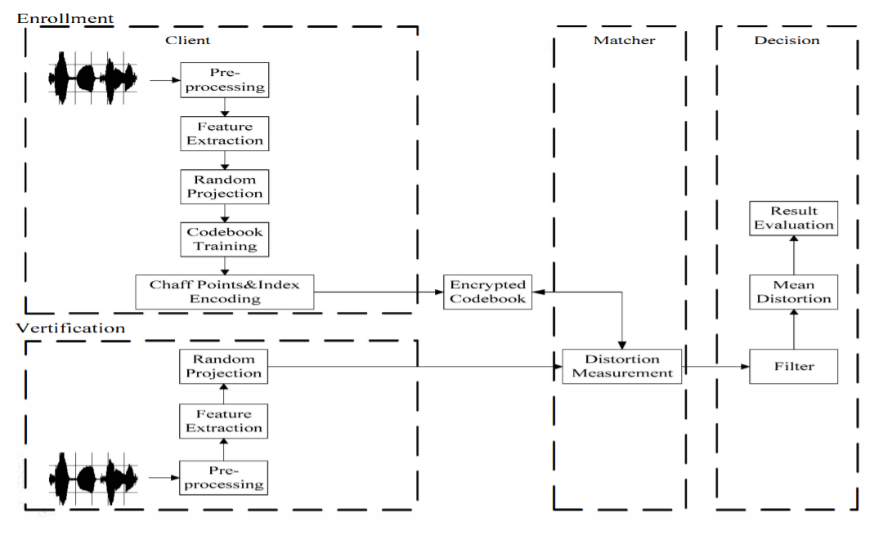
Block Diagram

Slide 10
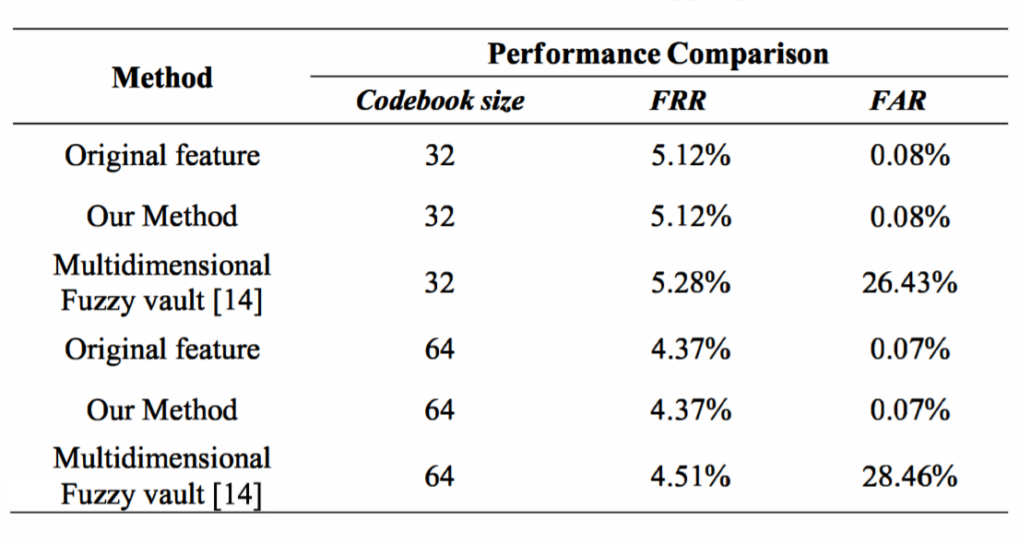
EXPERIMENTAL RESULTS
The experiment makes use of Mandarin continuous speech recognition training database as experimental data.
They selected 1600 sentences from 40 speakers in which 400 sentences are for training and other 1200 sentences for testing
The False Acceptance Rate(FAR) of the proposed method is observed to be much providential as compared to the Multidimensional Fuzzy vault Scheme. Both the FRR and FAR are observed to be same as the Original features.

Slide 11
Some Important Terms
Mandarin continuous speech recognition System: It makes use of a system that operates on speech in which words are connected together, i.e. not separated by pauses. The language used is Mandarin(Chinese).
FRR(False Rejection Rate): Is the probability of cases for which a biometric system inaccurately returns a no-match identification/verification.
FAR(False Acceptance Rate): Is the probability of cases for which a biometric system inaccurately returns a positive identification/verification.
Multidimensional Fuzzy vault Scheme: Is a biometric template protection scheme which makes use of a multidimensional template that “locking” the original biometric with the use of a secret key and verifies it by “unlocking” the vault with the help of a secret key.

Slide 12
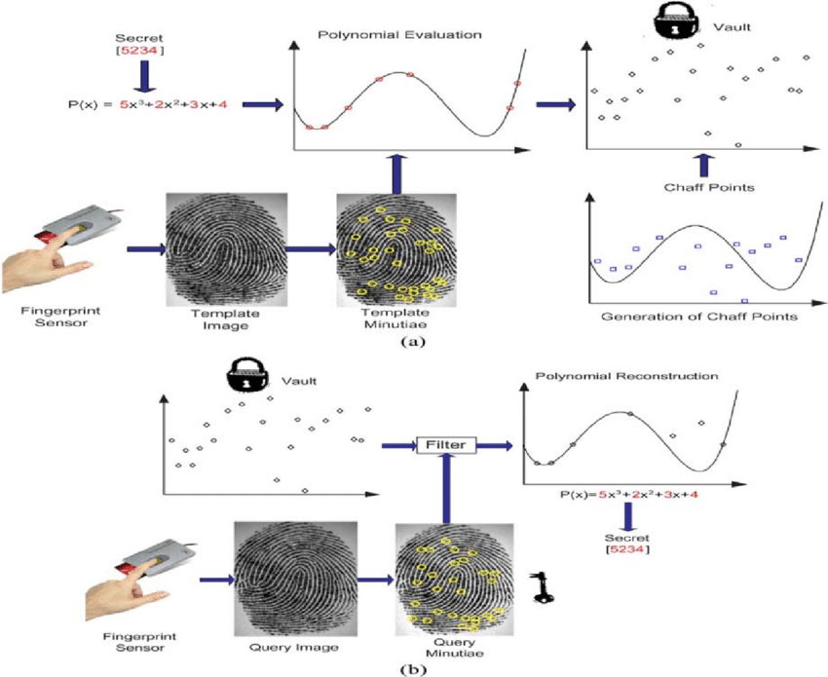
FUZZLY VAULT SCHEME

Slide 13
CONCLUSION
It employs the following methods to do so:
1: Random Projection
2: An Improved fuzzy vault scheme
This method overcomes the limitation of random projection and the fuzzy vault scheme.
Random projection improves the cancelability while chaff points conceal the genuine codewords to enhance the security.
The two step Hybrid approach addresses the following challenges in voiceprint verification Systems:
1: Template Cancelability
2: Privacy Protection

Slide 14

THE END

